Slide 1

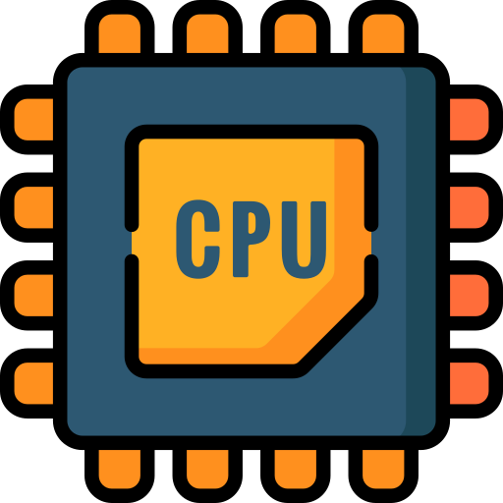
What Is a Computer?
Full-Stack Web Development Bootcamp

Slide 2

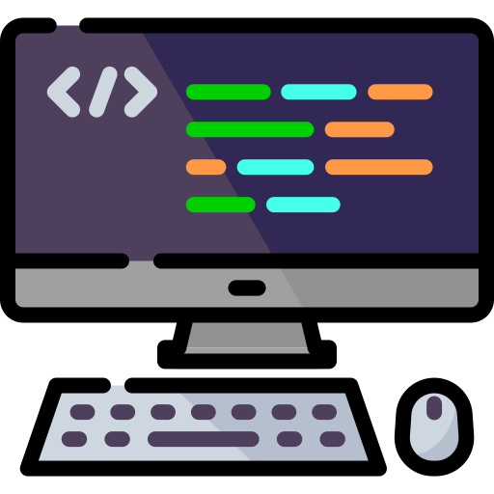
What is a Computer?
Definition of a Computer
A computer is an electronic device that processes data, executes instructions, and performs tasks through hardware and software to solve problems and automate operations.

Slide 3

A Combination Of Hardware and Software
Hardware
The physical components of a computer, including the processor, memory, and storage devices.
Computer
Software
Programs and applications that provide instructions for the hardware to perform specific tasks.
Notes:
Give example of different types of hardware
Examples of different type of software
This course is about creating software applications, special kind of applications which are often termed as websites or web applications

Slide 4


Three Important Components
Central Processing Unit
Storage
Random Access Memory
The Central Processing Unit (CPU) is the brain of the computer, responsible for executing instructions and processing data.
Storage is where data and programs are saved permanently, such as on a hard drive or SSD.
Memory (RAM) temporarily holds data and instructions for quick access by the CPU while tasks are being executed.
Notes:
Give examples of CPUs
Examples of storage
Ram is for temporary data which is needed while execution of a programs, fast speed and temporary in nature

Slide 5

Who Manages These Components?
Computer Hardware
User Input
Operating System
Notes:
Give examples of operating systems

Slide 6



Opening a Calculator Application
What is the role of each?
Applications On
Windows
Calculator Application
Notes:
Lets start understanding the flow of data on your computer

Slide 7
Loading Calculator Application
User Opens Calculator
Finds Calculator in Storage
Copies it to RAM for usage
Calculator
Operating System
Storage
RAM

Slide 8
How Calculator Works
Requests For A Calculation
Passes Instruction to App in RAM
App tells CPU to process request
Calculator
Operating System
RAM
CPU
2 + 2 = ?

Slide 9


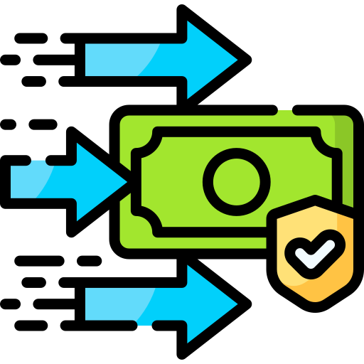
Why It Matters?
Scarce Resources
Many Users
Programmer
Money
Notes:
Resources are scarce – always
They will cost money
Your job as a programmers to save these resources

Slide 10
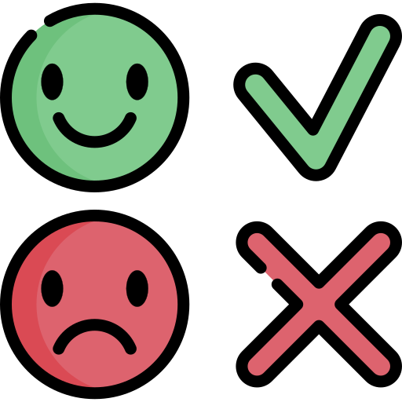
What Makes a Good or Bad Programmer?
Effective Use
Programmer
Good or Bad?
Notes:
A good or a bad programmer is defined by the resources your program uses
Always strive for effective utilization of resources
How to do it? The entire course is about that
I am sure you will learn programming and I am committed for that cause, that’s not difficult.
You will realis eventually, What separates a seasoned programmer from a newbie is how a programmer uses computing resources. That’s what differentiates a good programmer from a bad one.

